Slide 1

Multi-Classroom Leadership
Creating Your 90-Day Entry Plan
To copy or adapt this material, see OpportunityCulture.org/terms-of-use
Notes:
Notes about this session:
This session is designed to be presented at the end of a three-day summer training program.
The goal of this session is to help MCLs organize their thoughts, strategies, and goals so that they start the school year off with a clear plan.
This session walks attendees through the steps of identifying both a long-term goal for the year and a shorter-term goal that supports this long-term goal. The session also addresses how participants will measure progress and communicate their plans. The session can be lengthened to provide additional work time for participants, or they can plan to spend time after this session identifying their other goals and further building their plans.
Note about the handout called “Self-Assessment: Multi-Classroom Leader Training”
This optional handout is intended to help MCLs reflect on their knowledge and skills as they progress through the three days of training. It should be completed before the training starts, at the end of each session or day, and at the end of the full 3 days of training.
Advance preparation:
Please ask participants to bring (or have electronic access to) their school’s data, including summative/end-of-year test results, interim benchmarks, student attendance and discipline data, and teacher satisfaction survey results.
Please ensure that participants either have paper copies or electronic access to the handout “90-Day Entry Plan Outline”.
Participants should sit with their school teams if possible.
Estimated time: 1 minute
Facilitator says:
As you begin your MCL role, you probably have a number of goals you want to accomplish, and first steps you want to take. This session is designed to give you time to begin prioritizing your goals and planning how you will accomplish them. Research into how organizations in a variety of sectors get better quickly suggests that it is really important to accomplish short-term “wins” to build swift momentum for reaching long-term goals. For that reason, this session is designed to help you walk through the process of identifying both a long-term goal for the year and a shorter-term goal that supports this long-term goal.
[Optional]: First, please take out the handout called “Self-Assessment: Multi-Classroom Leader Training.” Please put a rating for yourself in the “initial rating” column for the “90-Day Planning” row.
Additional presentation options:
If the session facilitator has been an MCL or teacher-leader previously, he/she may want to tell a story about an experience starting the year, and how important it is to make specific plans for the beginning of the year in order to reach long-term goals.

Slide 2
Learning Objectives
During this session, participants will…
Identify three areas of highest need in your school
Create a long-term goal for the year aligned with an area of highest need
Create a short-term goal for the first months of school that supports your long-term goal
Plan how you will communicate both short- and long-term goals to key people: team teachers, parents, etc.
Notes:
Objective of this slide: Provide the learning objectives for this session.
Estimated time: 1 minute
Facilitator says:
In this session we will first:
Identify three areas of highest need at your school
Create a long-term goal for the year aligned with an area of highest need
Create a short-term goal for the first months of school that supports your long-term goal
Plan how you will communicate short and long-term goals to key people, including team teachers and parents and administrators
After this session, we hope you will follow the same process to create additional short- and long-term goals as needed to be ready for the start of school.

Slide 3


Importance of a 90-Day Plan
Use data to identify key goals
Identify quick wins to create buy-in
Create a culture focused on setting and meeting goals
Notes:
Objective of this slide: to explain the importance of the 90-day entry plan for setting the stage for success.
Estimated time: 2 minutes
Facilitator says:
We know you may have a lot of uncertainty as you take on your new MCL role, and you also probably have many things you want to accomplish. Just as you have a schedule to structure your day, having a 90-day entry plan will help channel your energy and focus your attention at the beginning of the school year so you can reach critical goals.
The 90-day plan should be rooted in facts and data, not opinions. Therefore, your school’s past data for your team’s subject(s) and grade(s)—and new students entering your classrooms—should be the starting point for your 90-day entry plan.
After you review the data, you will set both long- and short-term goals to help your school address areas of greatest need. The short-term goals should be designed to track progress and allow you to generate quick wins that will create buy-in.
Having an entry plan is also important because it helps you set the tone for the year with your team, by quickly creating a culture focused on setting and meeting goals.

Slide 4
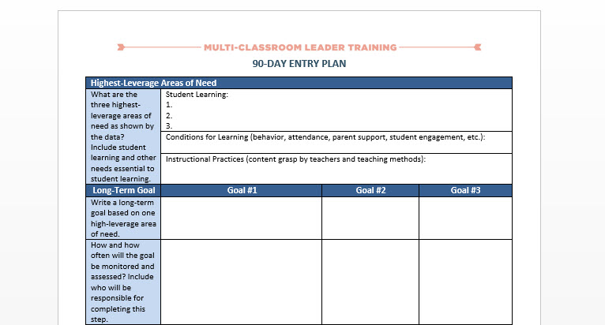
90-Day Entry Plan Outline
Notes:
Objective of this slide: to direct participants’ attention to the handout, the 90-day entry plan outline.
Estimated time: 1 minute
Facilitator says:
Please take out (or open electronically) the “90-Day Entry Plan Outline.”
Please keep this document open as we walk through an example.

Slide 5

Looking at Data
Notice:
What are the current levels of student performance?
What school culture issues could you positively impact as an MCL?
Are there any patterns or trends in the data?
Notes:
Objective of the slide: to walk participants through the first step in building a 90-day entry plan—reviewing the data to understand the school’s highest areas of need.
Optional extra: Videos of MCLs discussing goal-setting are at these links, if you want to show any:
https://www.youtube.com/watch?v=-lUQPD2Oq50&index=1&list=PLJA3DRwS0Egb4nfPeMasRFUCSHrxxlvj_
https://www.youtube.com/watch?v=2iOaO11S3ng&list=PLJA3DRwS0Egb4nfPeMasRFUCSHrxxlvj_&index=13&t=2s
https://www.youtube.com/watch?v=Z3FbzOYSwdQ&list=PLJA3DRwS0Egb4nfPeMasRFUCSHrxxlvj_&index=14&t=6s
https://www.youtube.com/watch?v=JISuikScUp8&list=PLJA3DRwS0Egb4nfPeMasRFUCSHrxxlvj_&index=15&t=8s
Estimated time: 2 minutes
Facilitator says:
The first step in creating a 90-day entry plan is to take a much longer view—where do you want your students and the teachers on your team to be by the end of the school year? You could answer this question in lots of different ways, but at a minimum you should think about:
Student achievement—where do you want students to be academically at the end of the year?
Culture—what kind of culture do you want to see in your team’s classrooms?
Teacher effectiveness—what kind of teaching will be happening on your team by the end of the year?
Many schools have already examined data and established schoolwide goals in each of these areas. If this is the case in your school, you should work with your principal and/or your school’s leadership team to make sure the goals you set for your team are aligned with these overall school goals. As an MCL, you are critical to helping your principals reach their school goals, so you should make sure you communicate regularly with the administrative or leadership team about how your goals fit in.
Then begin creating your 90-day plan by looking at your school’s data and asking yourself the following questions:
[click to animate] What are the current levels of student performance in the grades and subject areas where I will be leading a team? And for students entering my team’s classrooms?
[click to animate] What school culture issues could I positively impact as an MCL?
[click to animate] Are there any patterns or trends in the data?
Based on understanding these data, what are the greatest areas of need? An area of greatest need could be a specific student population that’s struggling, an instructional skill that teachers on your team need to improve, or an aspect of the work environment that teachers are unhappy about based on teacher working condition surveys.
To guide you through the creation of your own 90-day entry plan, let’s walk through an example. In this example, a 7th-grade MCL takes a look at her grade-level student data and sees that, on average, her students made less than one year’s growth last year in math. She selects 7th-grade student achievement in math as one area of greatest need and writes it in the first section of the 90-day entry plan [point out to the participants the top box of the 90-day entry plan].

Slide 6
SMART Goals
Specific and Strategic
Measurable
Action-Oriented
Realistic (or Robust!)
Timed and Tracked
Notes:
Objective of this slide: explain what SMART goals are (for the next section of the 90-day entry plan).
Estimated time: 2 minutes
Facilitator says:
After you’ve looked at the data and determined the areas of highest need, create goals based on those needs.
Many of you are probably already familiar with SMART goal statements, but just to review:
[click to animate] SMART goals are specific and strategic, detailed enough to determine achievement and have an important purpose.
[click to animate] They are measureable, with clear definition on how to measure impact or tell quantity or quality.
[click to animate] They are action-oriented, specifying who is taking action by using active verbs.
[click to animate] They are realistic—challenging, but achievable. Now, some people dispute this one and say that BIG goals, even if you fall short, are better than the “challenging but achievable” path. If you want to think this way, substitute “Robust” for “Realistic.”
[click to animate] And they include the timeline as well as how progress will be tracked, with benchmarks to define progress and a predetermined deadline.
SMART goals are not easy to write—that is a lot of information to pack into one statement—but research suggests that writing goals in this format helps provide clarity about how to achieve the goal.

Slide 7
Long-Term Goal
Write a long-term goal based on one high-leverage area of need. | As a result of weekly 7th-grade team data analysis, action planning, and data-driven lesson planning, students taught by the 7th-grade math team will show an average of 1½ years of growth on the end-of-year math assessment.
Notes:
Objective of this slide: use an example to demonstrate how to establish a SMART goal in the 90-day entry plan.
Estimated time: 2 minutes
Facilitator says:
In our 7th-grade MCL example, a long-term goal for math could be “As a result of weekly 7th-grade team data analysis, action planning, and data-driven lesson planning, students taught by the 7th-grade math team will show an average of 1½ years of growth on the end-of-year math assessment.” [point to the section on the template]
Notice that this SMART goal is:
Specific—providing in-depth detail about who would do what, by when.
Measurable—1.5 years of growth
Action-oriented—requires planning, data analysis
Realistic—not looking for three years of growth but one and a half. A “Robust” alternative might be 2 years of growth, or having no student below 1.3 years of growth. You might have other thoughts on what would be “robust.”
Timed and Tracked—end-of-year assessments and during-the-year assessments to monitor progress.

Slide 8
Long-Term Goal
How and how often will the goal be monitored and assessed? Include who will be responsible for completing this step. | The goal will be monitored by all 7^{th-}grade math teachers through quarterly common formative assessments.
How will adjustments be made? Include who will be responsible for this step. | Adjustments in the goal and action steps will be made by the 7th-grade team in data-driven action planning as needed. The MCL will be responsible for ensuring adjustments are made.
Notes:
Objective of this slide: walk the participants through completing the next sections of the 90-day plan using an example.
Estimated time: 1 minute
Facilitator says:
It is important to note that once a SMART goal is written, it must be constantly monitored, assessed, and adjusted as needed. You will need to be clear about how and how often this will happen, and who will be responsible.
In our example, the 7th-grade team would analyze quarterly common formative assessment data and adjust their data-driven action planning as needed. Adjustments in the goal and action steps would be managed by the 7th-grade MCL. [point to the section on the handout where this will be written in]

Slide 9
Long-Term Goal
How will you know when the goal is met? | When the 7th grade students show 1 ½ years of growth on the end-of-year math assessment.
Notes:
Objective of this slide: continue walking the participants through the SMART goal example to clarify how to build a 90-day entry plan.
Estimated time: 1 minute
Facilitator says:
You must determine how you will identify when a goal is reached. [point to the section on the handout]
In our example, the goal is reached when the 7th-grade students show an average of 1½ years of growth on their math end-of-year assessment.
Some of you may question whether this step is redundant as the SMART goal already included this measurable and time-tracked information. This question on the tool was meant to be a check for you in writing your goal. If your goal does not clearly state when it is met, this question should prompt you to adjust your SMART goal statement.

Slide 10
Short-Term Goal
 | Goal #1
Identify a short- term goal that will help you achieve your long-term goal. | 7th-grade math students on average will make 3.5 months of growth on the 1st quarterly common formative math assessment.
Notes:
Objective of this slide: explain the importance of setting short-term goals to create buy-in for the longer-term SMART goal, as part of the 90-day entry plan.
Estimated time: 2 minutes
Facilitator says:
Establishing short-term goals is important to produce short-term wins. These short-term wins inspire the team, create buy-in, and increase urgency and motivation. They also provide us with the ability to monitor whether we’re on track to reach long-term goals. As an MCL, after the team reaches a short-term goal, you will need to keep them motivated toward reaching longer-term goals as well.
In our example, one possible short-term goal that would help your students reach their long-term goal is to set a goal for 1st-quarter common formative math assessments. Using the data, a short-term goal could be that 7th-grade math students on average will make 3.5 months of growth on the 1st quarterly common formative math assessment. Based on the data, this goal will be a stretch, but is still attainable. [point to the section on the handout where this is to be filled in ]

Slide 11
Short-Term Goal
How and how often will the goal be monitored and assessed? Include who will be responsible for completing this step. | The 7th-grade math team will meet weekly to review data and make adjustments to intervention/enrichment groups and team lesson plans.
How will adjustments be made? Include who will be responsible for this step. | The MCL will adjust the intervention/enrichment groups and will reassign team teachers to groups based on data.
Notes:
Objective of this slide: continue walking the participants through the steps to build their 90-day entry plan with the short-term goals.
Estimated time: 1 minute
Facilitator says:
Just as you did with the long-term goal, specifying how, when, and who would be responsible for monitoring, assessing, and adjusting the goals, you need to do the same with the short-term goal. [point to the section on the handout where this is to be filled in]
In our example with 7th-grade math, the short-term goal around first-quarter assessments will be monitored and assessed by the 7th-grade math team based on available data, and the MCL is responsible for adjusting the intervention and enrichment groups, based on the data.

Slide 12
Short-Term Goal
How will you know when the goal is met? | When 7th-grade math students on average make 3.5 months of growth on the 1st quarter common assessment.
Notes:
Objective of this slide: complete the last part of the goal setting in the 90-day entry plan.
Estimated time: 1 minute
Facilitator says:
Finally, you must define how you will know when the short-term goal is met. Again, this is a check for you—you should have included this in your goal already, but if not, this serves as a reminder to go back and include it. [point to the section of the handout where this is located]
In our example, the short-term goal is met when 7th-grade math students on average make 3.5 months of growth on the 1st-quarter common assessment.

Slide 13
Action Steps
What action steps will you take to achieve the short-term goal? | 1. Use weekly assessments to guide content and pacing of lesson planning.
 | 2. Group students according to individual needs during intervention and enrichment time once per week. One group will be led by MCL.
 | 3. MCL will plan and deliver co-teaching session with teachers in blocks showing the highest need.
 | 4. MCL will create online enrichment activities delivered through a blended-learning rotation for highest-achieving students.
Notes:
Objective of this slide: helping participants set their action steps to reach their short-term goals in their 90-day entry plan.
Estimated time: 2 minutes
Facilitator says:
Merely setting goals isn’t enough to ensure success. A strategic series of action steps must also accompany the goals.
It is important to notice that so far in our example, we have just set a test-score goal. We also need to set instructional steps to meet the goal. [point to the section on the handout where this is to be filled in]
This section of the 90-day entry plan answers the question “How will we achieve this goal?”
For today’s work on your 90-day plan, your action steps will focus only on accomplishing your short-term goal. Notice that the action plan includes steps for monitoring and adjusting strategies.
Continuing the example, the MCL is going to use weekly assessments to guide content and pacing, group students by need, plan and deliver co-teaching sessions with teachers with the highest-need students, and create online enrichment activities.

Slide 14
Communication Plan
Who are the main people that this goal will affect? | 7th-grade math teachers, 7th-grade MCL, 7th-grade students and parents
Notes:
Objective of this slide: clarify the importance of identifying stakeholders and communicating the 90-day entry plan to them
Estimated time: 1 minute
Facilitator says:
Most goals cannot be achieved alone. Your goals and action steps must be communicated to the people most affected by this for both understanding and buy-in.
You first need to identify who those people are. Then, you should also think about how receptive each group will be to helping you reach your goals, and how you may need to influence them to achieve your goals. [point to the section on the handout where this is to be filled in]
In our example, the people most affected are 7th-grade math teachers, the MCL, and the 7th-grade students and parents.

Slide 15
Communication Plan
How will you communicate both short- and long-term goals to them? | MCL will develop and share long- and short-term goals with team teachers. Team teachers will communicate goals with students and parents. Students will track their weekly progress toward meeting the goals in their math folder and will have parents sign their folder.
Notes:
Objective of this slide: continue to build out the communication plan for the 90-day entry goal.
Estimated time: 2 minutes
Facilitator says:
After identifying the people this affects and reflecting on how supportive they are likely to be, you’ll want to determine how you will communicate about both your short and long-term goals with them.
Communication of the goals and action steps should be deeply embedded in all you do. Information about the goal, action steps, and any progress that you have made can be repeated in emails, meetings, lesson plans, and assessments. This will ensure that the goals are always on the minds of your team members. [point to the section on the handout where this is to be filled in]
In our example, the MCL shares both the long- and short-term goals with the team teachers, who are then responsible for communicating with student and parents.

Slide 16


Work Time
Create Your 90-Day Plan:
Student learning goals
Conditions for learning goals
Instructional practice goals
15 mins
End
Notes:
Objective of this slide: provide work time for participants to create their 90-day entry plan.
Estimated time: (including work time) 40 minutes
Facilitator says:
Now that we have walked through an example that highlighted a student achievement goal, it is your turn to review your data and select a long- and short-term student achievement goal. This should ensure that you take time before school starts to examine the data and set preliminary goals, but we recognize that you will definitely want to work with the teachers on your team to refine and review these goals when you begin meeting.
To get started, please take the next 15 minutes to review student performance data and set long- and short-term goals that reflect where you want your students to be academically at the end of the year, and the end of the first quarter or trimester.
[click to begin timer]
Now that you’ve had time to work on a student achievement goal, what other areas could your goals address?
[Listen for: School culture goals and instructional goals such as:
Impact of the MCL on the culture of the team
Communication of the MCL role in the teaching team and school community
Creating a culture of feedback and coaching
Improving a specific instructional skill
Creating a growth mindset]
In addition to student learning goals, research about schools that beat the odds indicates that you may want to consider at least two other categories for goals essential to learning:
Conditions for Learning—This includes goals to establish a safe and orderly learning environment and a strong home-school connection. This might include goals for student attendance, student discipline rates, parental support of healthy lifestyles that support learning, and classroom climate (or how engaged students are at any given time). Example: Attendance rates at 95% by end of first quarter; maintain for whole year.
Instructional Practices—This includes major curriculum goals and goals related to improving instructional skills in target subjects. Example: Whole 7th-grade math team trained in scaffolding instruction by end of first quarter—with emphasis on highest level of student thinking demonstrated in independent work—and routinely incorporating into lesson plans by end of year.
Including goals in these categories can give your team actionable steps to achieve learning: Changing tactics so that students are in class, engaged in learning, not engaging in disruptive behavior, and with parents supporting a healthy diet, sleep, and exercise habits. Teachers must know the curriculum content and develop their abilities to teach that content to improve learning outcomes.
Choosing two or more goals among these for your first 90 days—areas that need the most improvement—can help you achieve your team’s learning goals.
Take the next 20 minutes to work on the rest of your preliminary plan. Try to complete as much of the plan as possible now and during the remainder of the summer, knowing how busy things will get once school starts. Try to include at least one long- and short-term student learning goal, and one goal each for strong conditions for learning and instructional practices.
[click to begin timer]
Additional presentation options:
Give participants the option to pair and share for feedback.
Provide additional time for the participants to work on the plan if your session allows.
Start the participants on a goal other than student achievement if their needs are stronger elsewhere.

Slide 17
Accountability
How will you be accountable for the goals?
How will you check in on your progress?
Notes:
Objective of this slide: allow participants to work with those at their school to discuss how they will hold one another accountable. If there are MCLs who do not have others from their school, consider pairing them with someone whose position is most similar to theirs.
Estimated time: 6 minutes (including work time)
Facilitator says:
Take the next 5 minutes to discuss accountability measures for the goals you have created with the MCLs or administrators from your school.
Decide how you will hold yourselves and one another accountable for meeting your goals and how you will check in on progress.
Consider scheduling meetings or quick email check-ins on your calendar.
[click to begin green circle timer]

Slide 18
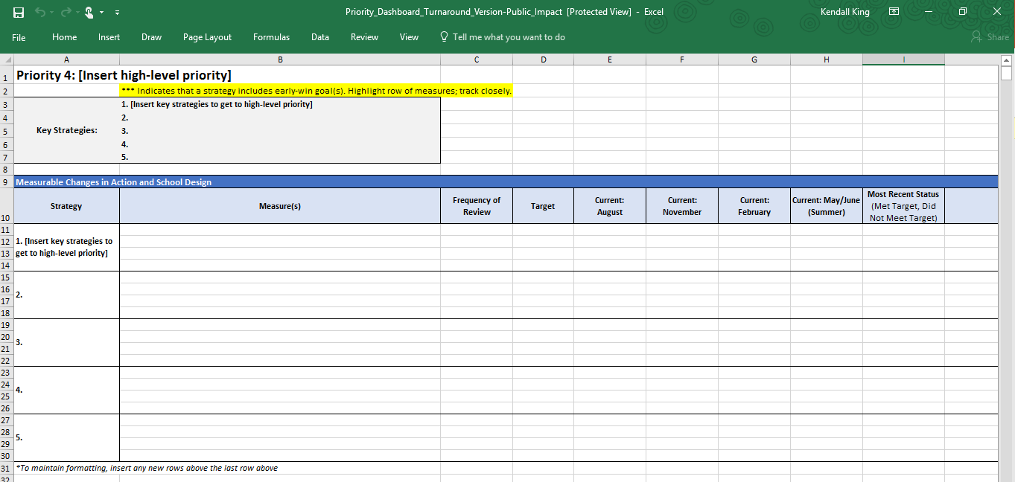
Priority Dashboard
Notes:
Note: Consider providing access to this Excel spreadsheet in a shared folder (Google Drive, Dropbox, etc.).
Objective of this slide: Orient participants to a tool that could be helpful to monitor and track progress towards goals throughout the year.
Estimated time: 2 minutes
Facilitator says:
One tool that could be helpful to monitor and track progress throughout the year is this Priority Dashboard. [Click picture to open link. Walk participants through the priority dashboard, starting with a blank page (tab 4), then showing that several sample tabs already exist with suggested strategies and measures to track.]
Sometimes people make the mistake of tracking too much! When using a document like this, it is important to consider what is feasible and sustainable to track throughout the year. However, choosing to NOT track progress can lead to forgetting about goals and ultimately not making progress. In order to keep something at the forefront, you should track progress regularly and analyze the root cause behind why goals are or are not on track.
Many principals or MCLs choose to take this dashboard and make it their own!

Slide 19
Launching Your First Week
How will you:
Get to know your team?
Establish and communicate norms and expectations?
Communicate the MCL role and schedule?
15 mins
End
Notes:
Objective of this slide: for participants to reflect on the actions they will take during their first week of school (versus the first 90 days)
Estimated time: 18 minutes (including work time)
Facilitator says:
You are well on your way to planning for success in the first 90 days, but what are you going to do during your first week of school?
Take the last 15 minutes of this session to determine five actions you will take to begin your new role and begin to build a team focused on success.
What are some ideas from the sessions that you think will help you build your team during this critical first week?
[Listen for:
Team building and icebreaker activities
Creating norms
Share the organization chart
Share the MCL schedule]
[click to begin timer]
[Optional] Finally, please pull out the handout on “Self-Assessment: Multi-Classroom Leader Training,” and add a rating to the “post-session rating” column, and for the “summative reflection” lines.

Slide 20
Resources for Additional Learning
http://www.theleadershipnotebook.com/2012/09/your-first-90-days.html

