Slide 1
Multi-Classroom Leadership
Coaching Day Introduction

Slide 2
Review Day 1
Defining the MCL Role
School and District Support for MCLs
Launching Leadership
Delivering Effective Feedback: Mindsets
Notes:
Note: Modify this slide if the sessions shown on it do not match what sessions were delivered on Day 1.
Objective of this slide: Review Day 1 sessions
Estimated time: 2 minutes
Facilitator says (throughout the slides, put this in your own words):
Yesterday, we talked about your new MCL role, the support structures you have at the school and district level to support you in your role, and how to launch leadership and your team, and we set the stage for thinking about supporting adults by learning about and practicing giving growth-oriented feedback.
Before we dive into Day 2, I’d love to hear some reflections on Day 1. What were some of the key takeaways you had when you left the session yesterday? These could be “aha” moments, next steps you set for yourself, or things you wonder about as you look ahead to today and tomorrow. [Have 2 or 3 volunteers share.]

Slide 3
Action Planner for MCLs
© 2016 Public Impact OpportunityCulture.org
Notes:
Objectives of this slide: Remind participants to take note of action steps they think of throughout the day.
Estimated time: <1 minute
Facilitator says:
If you turn to page three of the action planner, you can see some of the suggested summer actions under Leading a Team and Achieving Instructional Excellence. Today’s sessions focus on planning what excellent teaching looks like for you, and planning how to coach your teachers.
Remember, as we go through today, if you think of any new action steps to do this summer, you can keep track of your thoughts in your action planner.

Slide 4
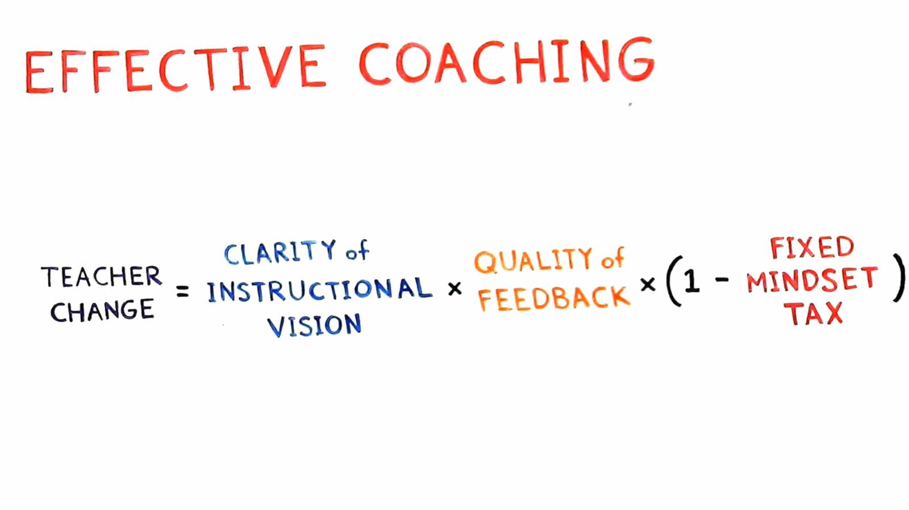
Video: Coaching
Source: Match Education. Match Minis. “Running Effective Coaching”
Notes:
Video link: https://www.matchminis.org/videos/for-coaches/38/running-effective-coaching/
NOTE: the embed function is disabled for this video, so click on the linked image in the slide, which will open the web browser. Click “skip” to bypass their registration page. Then click the “play full screen” icon on the bottom right. Click “esc” when finished to exit full screen mode.
Objective of this Slide: Participants watch video about components of coaching and reflect on what is familiar and what is new.
Estimated Time: 5 minutes
Facilitator says:
We’re going to be incorporating a couple of frameworks and strategies to talk about effective coaching today, but first we want to start off with a quick video from Match Minis that we think does a good job of framing the topics we will dive into today. While you watch, write down some notes about things you hear that are familiar to you from previous experiences as a coach or being coached, and things that are new or different than your previous experiences with coaching.
[Play video.]
[After video, have a few participants share their thoughts.]

Slide 5
Coaching
What to Coach
How to Coach
Notes:
Objective of this slide: Provide framing for the day—what to coach and how to coach
Estimated time: <1 minute
Facilitator says:
The coaching skills we’ll learn about and practice today will be essential to your role as an MCL. While coaching isn’t the only thing an MCL does, it is one of the most important functions of the role, to develop team teachers to have an increasingly greater impact on student learning. We’ve broken the day into two key topics: What to Coach [click to animate], similar to the “Clarifying Instructional Vision” piece mentioned in the video, and How to Coach [click to animate], which dives into quality feedback. We want you to leave with strategies for identifying instructional strengths and areas of growth for your team teachers, a clear approach for facilitating a coaching cycle and conversation, and time to practice how to support your teachers to improve their instruction.

Slide 6
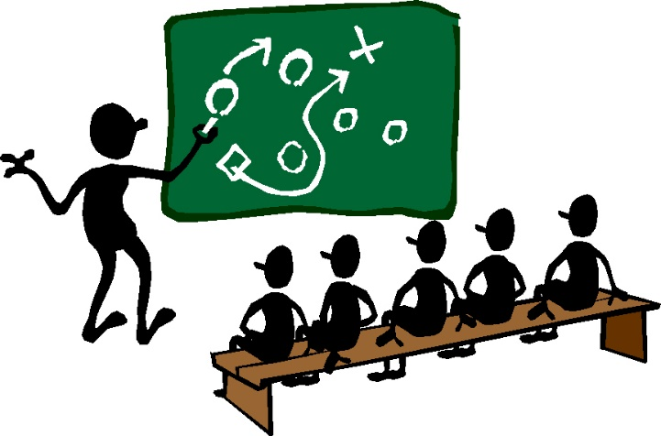
What to Coach
Define instructional excellence and explore resources to help coach toward instructional excellence.
Discuss how to prioritize the components of excellent teaching to best meet the needs of individual team teachers.
Observe teachers in action and practice choosing the highest-leverage action steps.
Notes:
Objective of this slide: Review objectives for “What to Coach” session
Estimated time: <1 minute
Facilitator notes:
The first session will be focused on What to Coach and dive into the concept of instructional excellence.

Slide 7
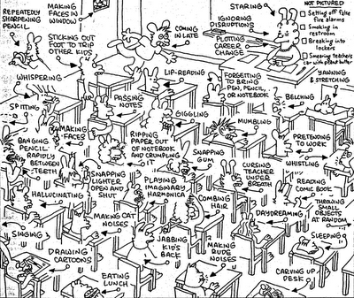
What to Coach: Instructional Excellence
Notes:
Objective of this slide: Provide more context on “What to Coach” session
Estimated time: 5 minutes
Facilitator notes:
The “What to Coach” session today focuses on thinking about the actual teaching skills you can support your teachers with. The best way to explain the goal of the session is through some illustrations.
[click for first picture of crazy classroom] Let’s say it’s Day 1 of the school year and you walk into one of your team teacher’s classrooms and see this.
How many things do you see that you could potentially address in this classroom?
[Listen for: too many to count. Everything.]
Exactly. As an experienced teacher yourself, you are likely to walk into a classroom and immediately see 15 things you want to change right away. So the question becomes: Where do you start? How do you prioritize?
[click for second picture of engaged classroom] As an MCL, you may also walk into a classroom like this.
What’s different about this image compared to the last one?
[Listen for: Students are engaged, things are orderly, teacher is working with small groups, more learning is happening.]
Great. But as an MCL, you are still responsible for helping this teacher and her students grow even more. So even though this teacher has things under control and appears to be doing pretty well, you have to identify the skills that will help take her from good to great or great to excellent. An MCL isn’t there just to support early-career or struggling teachers, but for all teachers to have effective support at any point in their careers.
[click for both pictures to appear together] In the “What to Coach” session, we’ll use the collective experience and expertise in this room to think about what makes instruction excellent and provide some resources to help you think through the instructional skills that you can focus on as an MCL with your team teachers, regardless of where they are in their development.

Slide 8
How to Coach
Define coaching and discuss the components of a coaching cycle.
Learn about tools used during informal observations and practice using tools in real time.
Learn about and practice using Leverage Leadership’s Six Steps for Delivering Effective Feedback to lead coaching conversations.
Explore ways to follow up coaching conversations with team teacher practice activities.
Notes:
Objective of this slide: Review objectives for “How to Coach” session
Estimated time: <1 minute
Facilitator notes:
The second session will be focused on How to Coach. We’ll spend time thinking about what we do as MCLs to support teacher development once we’ve identified their instructional strengths and growth areas.
At the end of the day, we will do a final application activity where we combine the knowledge and skills learned, watching a video of a lesson and planning how we would coach the teacher to improve.

Slide 9
How to Coach: The Coaching Cycle
Build relationship, set vision, and set norms for roles and expectations
Observe teaching, looking for implementation of action steps
Facilitate debrief conversation to deliver feedback and identify action step(s)
Provide interventions, as needed (model lesson, co-teach, etc.)
Notes:
Objective of this slide: Briefly introduce the coaching cycle and that coaching is an iterative process.
Estimated time: <2 minutes
Facilitator says:
The “How to Coach” session focuses on developing your adult leadership skills to lead your teachers to improve their instructional skills.
We’ll dive into the components of a coaching cycle. Some of you may have experience with different approaches to coaching and may have seen or used other coaching cycles. They’re generally pretty consistent in their main components and are similar to this one. During the How to Coach session, we’ll talk about building relationships with teachers, observing teacher practice, facilitating coaching conversations to support teachers with identifying their action steps, and finally providing interventions and support to help teachers develop.
[click to animate] Let’s define “action step” at this point, as it comes up in both sessions. An action step is the specific instructional skill or strategy a teacher is working on and expected to implement immediately in the classroom. For example:
A team teacher is working on classroom management, so the action step is to describe positive behavior when it happens (“narrative the positive”) where the teacher provides explicit directions, then describes aloud what students who are on task are doing to follow those directions, to encourage all students to follow suit.
Or, a team teacher is working on increasing rigor during whole-group instruction by getting students to do more analytical thinking, so the action step is to ask students to answer a more difficult extension to a question to increase the complexity of their thinking (sometimes called “stretch it”).

Slide 10
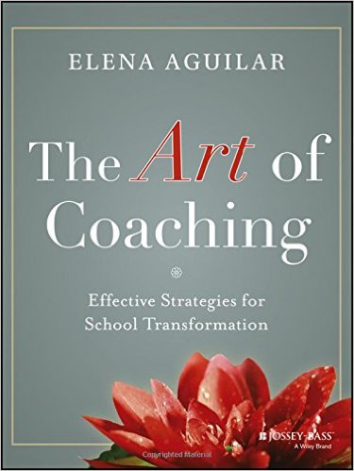
How To Coach: Coaching Models
Real Time Coaching
Notes:
Objective of this slide: Acknowledge that there are many different coaching frameworks and state why we’ll be using Leverage Leadership for this training.
Estimated time: <1 minute
Facilitator says:
What coaching frameworks have you used in previous roles and/or will you use at your school?
[Listen for: GROW, Leverage Leadership (Paul Bambrick-Santoyo), Art of Coaching, Real Time Teacher Coaching (CT3)]
[click to animate] There are many different coaching frameworks out there that you may use at your school, including GROW, The Art of Coaching, Leverage Leadership, and others. Today, we’re using one strong framework that some of the most successful MCLs across the country use—Leverage Leadership. As we practice today with Leverage Leadership, please engage fully even if this is not the framework used at your school. Since they all share a common structure, you will be able to take this practice and apply it at your school.

Slide 11
Sources
Match Education. Match Minis. “Running Effective Coaching”

