Slide 1
Reach Associates
Supporting Differentiated Instruction
in the Classroom
Notes:
Notes about this session:
This session is intended to help understand how the RA role supports differentiation, and practice strategies.
Advance preparation for this session:
Please print out or make electronically available:
Handout—Jigsaw Puzzle Differentiation Activity—print out 1 color copy for every 4 participants
Create “home group packets”—1 packet for every 4 participants. Each home group packet will need 1 handout for each of the following “puzzle piece” areas: Environment, Readiness, Learning Profile, and Interest. Note that the handouts are the same as slides 11-15. If the total number of participants is not divisible by 4, then include groups of 5 and two people in a group will pair up to both focus on one puzzle piece.
Please print out or make electronically available enough copies for each attendee:
Handout—Differentiation Think-Pair-Share
Materials needed:
Posters labeled Environment, Readiness, Learning Profile, or Interest; write questions on slide 17 on each poster
Markers
Sticky notes
Poster at front of room for exit tickets
Estimated time: 1 minute
Facilitator says (throughout the slides, put this in your own words):
The reach associate role has the potential to greatly accelerate student learning, especially by supporting differentiated instruction in the classroom for teams of teachers. The reach associate makes it possible for MCLs and teams of teachers to carry out the differentiation that they plan for when developing lessons to help all students.
Before we begin, I want to emphasize again the importance of how different the reach associate role looks in every school and classroom. Some reach associates implement lesson plans, developed by the team teacher, to a whole class for an hour. Other reach associates pull small groups of students for more practice on specific benchmarks, depending on interim assessments. Still others are growing in their teaching practice as an aspiring teacher and are coached very closely by a teacher-leader, or MCL.
We hope that during this session about differentiation, we have differentiated so that you gain a better understanding of what differentiation is, and get some tools to support you as you support differentiation in the classroom.

Slide 2
Do Now
What would help you answer this question?
“Why do sunflowers always face the sun?”
Image source: https://www.scienceabc.com/nature/sunflowers-always-face-follow-sun.html
Notes:
Objective of this slide: to activate prior knowledge of differentiation and provide information for the facilitator to use in order to differentiate during the session.
Estimated time: 5 minutes
Facilitator says:
As you get settled, please complete the following DO NOW.
On your own piece of paper reflect on what would help you answer this question: “Why do sunflowers always face the sun?”
You may reflect on your own learning experience as a student.
You may choose to answer this question in any format you’d like—write text, draw, make a diagram, etc. Think about how you learn best. Be creative!
After 3 minutes, let’s have volunteers share.
[The facilitator can share his/her answer first to help break the ice.]
[Example: I learn best by studying diagrams—pictures in a sequence and then acting it out. Science vocabulary is really hard for me to memorize, so I do best when we have scripts to memorize and then a play to act out the scientific process. This way I really get to think through movement about how plants adapt to the sun and the complicated process for why a sunflower would always face the sun!
Could a few people share now?
We all learn differently and need different supports to answer questions. This is essentially, differentiation.
[EXTRA! For those curious—why do sunflowers always face the sun? “The fascinating phenomenon of flowers following the sun across the sky is called heliotropism. The question is, what makes them do this? The sunflower plant contains hormones called auxins. These hormones are sensitive to sunlight and do everything they can to seek shade! Therefore, they migrate from the part of the plant bathed in sunlight to the shaded region in the stem. Once there, the auxins (which are essentially growth hormones) stimulate the growth of cells. This causes the stem to become bulkier in the shaded region, so the flower ends up bending in the opposite direction, toward the sun!”
Source: https://www.scienceabc.com/nature/sunflowers-always-face-follow-sun.html
Optional:
Engage:
To pull the participants back to whole group, the facilitator can use an activation strategy such as “rhythm clapping, repeat after me, etc.,” or even ask participants what works best for them in the classroom.

Slide 3
Learning Objectives
During this session, participants will…
Learn what to consider when supporting all students with differentiated instruction in the classroom and how your RA role can support differentiation.
Practice a strategy and identify a resource for differentiation that you and your team of teachers can apply in the classroom.
Notes:
Objective of this slide: to present the learning objectives for this module.
Estimated time: 1 minute
Facilitator says:
Knowing that a lot of reach associates are not involved in lesson planning, and they carry out very different responsibilities as guided by their MCL, DRT, or team of teachers, we hope this session is differentiated for you.
Ultimately, our goal is to ensure that we adjust instruction to reach all students.
During this session, we will:
[click to animate] Learn what to consider when supporting all students with differentiated instruction in the classroom and how your RA role can support differentiation.
[click to animate] Practice an approach to differentiation that you can apply in the classroom.

Slide 4
What is Differentiating Instruction?
Differentiating is tailoring instruction to meet students’ individual needs.
Improves learning
A way of teaching
Focused on students
Recognizes diverse learners
Gives options for taking in information
Adapted from: Tomlinson, C. A. (2014). The Differentiated Classroom: Responding to the Needs of All Leaders
Notes:
Objective of this slide: to understand what is differentiating instruction.
Estimated time: 3 minutes
Facilitator says:
To think about differentiating—tailoring instruction to meet students’ individual needs—look at this slide.
What is similar? What is different?
[Listen for: all 2D shapes, all blue, all generally the same size, but with different number of sides, different names for the shape.
And, different ideas expressed! Differentiating is …
[Click to animate] A way of teaching
[Click to animate] Focused on students
[Click to animate] It improves learning
[Click to animate] Recognizes diverse learners
[Click to animate] And gives options for taking in information.
These concepts are from Carol Ann Tomlinson, who has thought a lot over the past two decades about using differentiation to reach all students.
Adapted from: Tomlinson, C. A. (2014). The Differentiated Classroom: Responding to the Needs of All Leaders, 2nd edition, Alexandria, VA: ACSD

Slide 5
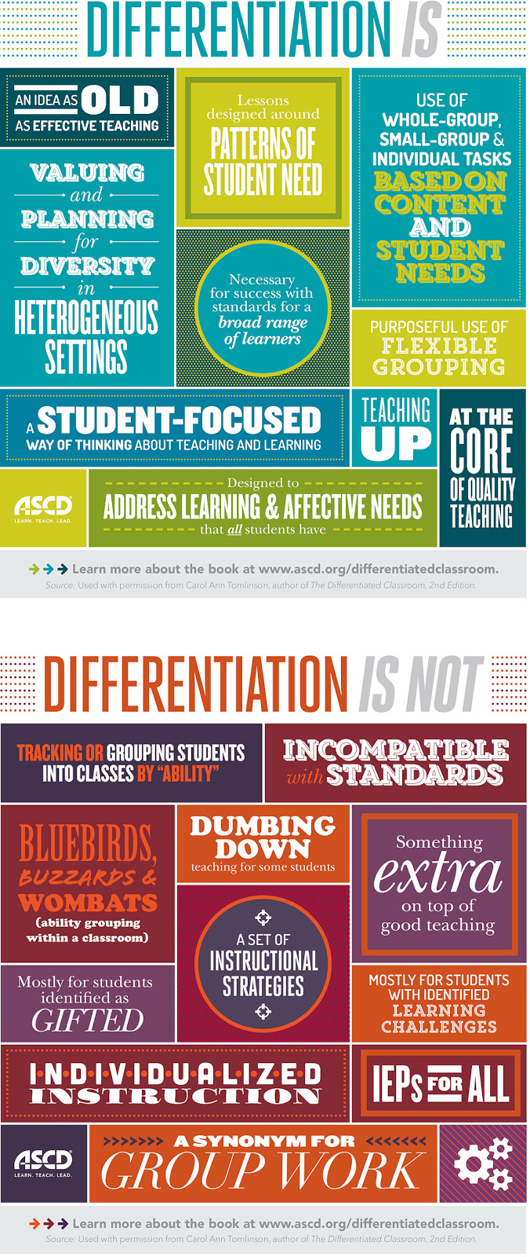
Think—Pair— Share
Image source: http://www.teachthought.com/pedagogy/the-definition-of-differentiated-instruction/?crlt_pid=camp.aHEOcIFZA9IK
Notes:
Objective of this slide: to understand what is and what is no differentiating instruction.
Estimated time: 7 minutes
Materials Needed: Handout—Differentiation Think-Pair-Share Activity
Facilitator says:
Let’s do a think-pair-share to compare and contrast what differentiation is and is not.
Think. Take a few moments to read through these graphics and go through the guiding questions on the handout.
What resonates with you?
What surprises you?
How does this affect what you do in the RA role?
Now, pair up with your neighbor to discuss your answers.
Could two groups share their thoughts? Tell us not your thoughts, but what your partner said.
[Listen for:
It resonates with me that differentiation is based on student needs and is student focused;
I was surprised that student groups weren’t the only way to differentiate or that the groups should be based on mixed ability;
As an RA, I can help a teacher by being another adult in the room who can help facilitate a guided reading group while he/she works on re-teaching a lesson to students who haven’t yet mastered the objective. ]

Slide 6
How Can Teacher Teams Support Differentiating Instruction?
Potential Role of Reach Associate
Provide input about learners Prepare materials before class Carry out aspects of lesson plans Use and create tools to effectively manage a differentiated classroom
Collect assessment data Enter into tracking systems Highlight areas to address
Role of MCLs, direct-reach teachers, team teachers | Potential Role of Reach Associate
Develop lesson plans intentionally with differentiated instruction
Use assessment and other student data to drive differentiated instruction
Notes:
Objective of this slide: to discuss some of the ways that teacher teams, including Reach Associates support differentiating instruction.
Estimated time: 5 minutes
Facilitator says:
On most teams of teachers, especially using Opportunity Culture models, the role of MCLs, direct-reach teachers, and/or team teachers is to develop lesson plans intentionally with differentiated instruction, and use assessment and other student data to drive differentiated instruction.
While intentional planning and assessment is not the role of the reach associate and outside your control, there are still ways that RAs can support differentiating instruction to help reach all students.
How do Reach Associates support these teams of teachers in supporting differentiation in the classroom?
[click to animate]
[NOTE: If participants have some experience in the classroom, ask for examples before clicking to animate.]
What else do you do as RAs that supports differentiation in the classroom for your team of teachers?

Slide 7
What to Consider When Supporting Differentiated Instruction
Learning Profiles
Environment
“Lying on the carpet during reading helps me relax.”
“Looking at maps when I learn helps me see what we’re talking about!”
ENVIRONMENT
ENVIRONMENT
Readiness
Interest
“I feel supported when Ms. Kay helps me with math by myself.”
“I love volcanos and all things science!”
Adapted from: McCarthy, J. (February 6, 2015). Differentiation Is Just Too Difficult: Myth-Busting DI Part 3. Edutopia. Retrieved from: http://www.edutopia.org/blog/differentiated-instruction-myth-too-difficult-john-mccarthy and Tomlinson, C. The Differentiated Classroom: Responding to the Needs of All Leaders, 2nd edition, ACSD, 2014
Notes:
Objective of this slide: to outline what to consider when differentiating instruction.
Estimated time: 5 minutes
Facilitator says:
How do we get detailed knowledge about our students? Let’s listen to them!
Your role in the classroom is often to be the eyes and ears for the team teachers and MCLs, forming relationships with students. This relationship is integral when “hearing” from students what to consider when differentiating instruction.
Let’s take a poll. Think about the students you work with or have worked with in the past. What have you heard from your students about what they need to be successful in the classroom? Or what do you think students would say if you asked them?
[Use the terms (Environment, Readiness, Learning Profile, and Interest) on the slide to help prompt the group response of student voices]
Let’s look at the different components—could I have a volunteer read out a student response for…
[Click to animate] Environment
[Click to animate] Readiness
[Click to animate] Learning profiles
[Click to animate] Interests
Adapted from: McCarthy, J. (February 6, 2015). Differentiation Is Just Too Difficult: Myth-Busting DI Part 3. Edutopia. Retrieved from: http://www.edutopia.org/blog/differentiated-instruction-myth-too-difficult-john-mccarthy
Adapted from: Tomlinson, C. The Differentiated Classroom: Responding to the Needs of All Leaders, 2nd edition, ACSD, 2014

Slide 8
Jigsaw: Supporting Differentiation Strategy
What is it?
Collaborative learning strategy
Creates home groups of students, dividing them into specialized groups to “dive in” to a topic, then return back to home groups to share
Fosters positive interdependence in the classroom with each participant, which is essential
Adapted from: Aronson, E., & Patnoe, S. (2011Cooperation in the Classroom: The Jigsaw Method (3rd ed.). London: Pinter & Martin Ltd. and https://www.jigsaw.org
Photo Source: Creative Commons License https://openclipart.org/detail/172877/puzzle
Notes:
Objective of this slide: to learn an overview of “Jigsaw,” a differentiation strategy.
Estimated time: 2 minutes
Facilitator says:
Now we’ll try a popular differentiation strategy called “jigsaw.” Have any of you used “jigsaw” before in the classroom as a student or adult? [If so] What was particularly helpful about this strategy? [If not] Great—let’s try something new!
First, what is it? Really, it’s like the concept of a jigsaw puzzle—all parts are equally important and need to fit together to make something bigger.
[click to animate]: It’s a collaborative learning strategy…
[click to animate]: that creates home groups of students, dividing them into specialized groups to “dive in” to a topic, then return back to home groups to share…
[click to animate]: and that fosters positive interdependence in the classroom with each participant, which is essential
Adapted from: Aronson, E., & Patnoe, S. (2011Cooperation in the Classroom: The Jigsaw Method (3rd ed.). London: Pinter & Martin Ltd. and https://www.jigsaw.org

Slide 9
Jigsaw: A Strategy for Understanding Texts
Video Source: Teaching Channel
Notes:
Objective of this slide: to learn an overview of “Jigsaw,” a differentiation strategy.
Estimated time: 3 minutes
Facilitator says:
Here’s a teacher in a 6-8th-grade ELA classroom in Washington state who uses Jigsaw; we’ll watch a 2-minute video about it [NOTE: To play the video, click on the linked image in the slide, which will open your web browser. Click to play the video, then click the “play full screen” icon on the bottom right. Click “esc” when finished to exit full screen mode.]
Any questions about this method that we will practice?
Video Link: https://www.teachingchannel.org/videos/jigsaw-method

Slide 10
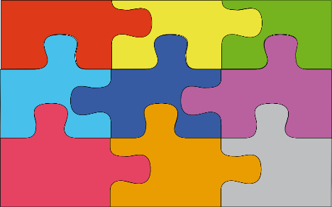
Jigsaw: Supporting Differentiation Strategy
STEP 1: Each person at the table chooses a different
colored puzzle piece
STEP 2: Read the handout and brainstorm examples
STEP 3: Join your puzzle piece group and answer
guiding questions
STEP 4: Return to your home group and share
Notes:
Objective of this slide: to get an overview of the “Jigsaw” steps for this activity.
Estimated time: 2 minutes
Materials needed: For Step 2, the handouts are the slides 10-14 in this deck, which are available as either paper or electronic handouts to accompany the slide deck.
Facilitator says:
Before we begin with the jigsaw activity, I’ll model for you all the importance of “frontloading” in jigsawing. That means providing very clear preparation and directions to students at the beginning of the activity to help it go as smoothly as possible. Of course, you will refine this as time goes on, learning lessons from each attempt. After a few jigsaw lessons, students (and adults!) learn the system and fall into an efficient routine.
Let’s go through the steps of the jigsaw.
STEP 1: Choose your puzzle piece
STEP 2: Read over the handout and complete the response activity
STEP 3: Join your puzzle piece group and answer guiding questions
STEP 4: Return to your home group and share
Any questions so far? Or suggestions from those who have done jigsaw before?

Slide 11
Jigsaw: Supporting Differentiation Strategy
Learning Profiles
STEP 1:
Each person at the table choose a different-colored puzzle piece
(1 minute)
Environment
Interest
Readiness
Notes:
Objective of this slide: Participants select a puzzle piece, or content area: Environment, Readiness, Learning Profiles, Interest
Estimated time: 2 minute
Materials needed: Home group packets including one each of the following handouts 1) jigsaw puzzle pieces, 2) Environment, 3) Readiness, 4) Learning Profiles, 5) Interest. You will need 1 home group packet for every 4 participants. If the total number of participants is not divisible by 4, then include groups of 5 and two people in a group will pair up to both focus on one puzzle piece.
Facilitator says:
First, get into groups of 4—this will be your “home group.” If we can’t divvy up into a group of 4, then it’s better to have a group of 5, with two people pairing up to focus on one puzzle piece.
Then each of you will choose a different-colored puzzle piece that you would like to explore during this jigsaw activity.
Today, we have four pieces, connected to what we can consider when supporting differentiated instruction in the classroom.
Pink = environment
Light blue = learning profiles
Orange = readiness
Dark blue = interest
Let’s get started! Choose your puzzle piece! 1 minute, GO!
Narrate when 20 seconds remaining.

Slide 12
Jigsaw: Supporting Differentiation Strategy
Learning Profiles
STEP 2:
Read the handout and brainstorm examples
(10 min)
Environment
Interest
Readiness
Notes:
Objective of this slide: Participants read their puzzle piece handout individually and complete the response activity.
Estimated time: 10 minutes
Materials needed: Home group packets including one each of the following handouts 1) jigsaw puzzle pieces, 2) Environment, 3) Readiness, 4) Learning Profiles, 5) Interest.
Facilitator says:
For step 2, each participant will read their puzzle piece handout individually and brainstorm examples.
Can I have a volunteer to repeat the directions back to the group? (Provide clarity if there’s confusion)
I’m going to walk around and pass out the handout for your specific puzzle piece. When you have your handout, go ahead and begin. You have 8 minutes, go!
Narrate when 2 minutes remaining.

Slide 13
What to Consider When Differentiating Instruction?
Environment
Overview | Examples
Students’ comfort in the classroom’s physical environment
Readiness
“Lying on the carpet during reading helps me relax.”
Notes:
Objective of this slide: to outline what to consider when differentiating instruction and brainstorm examples.
Facilitator note: This slide is one of the handouts to participants, and you can choose to display during the small-group exercise.
Facilitator will circulate around the room and help participants with the following guidance:
What to consider when differentiating instruction?
Let’s look at the students’ comfort in the classroom’s physical environment.
Some students may be introverted and thrive in individual desks; extroverted students may benefit from group tables to discuss concepts.
What are some other examples?
[Other examples: some students may need a change in environment to focus, and do better on the carpet, near the teacher’s desk, or on computers—whereas some students may not thrive there.]
What you can do is be observant, listen to your students, and think about the classroom’s physical environment and what each student may need to thrive in the classroom.
What are some other examples of physical environments that students may or may not thrive in?
[Noise, light, yoga balls, standing desks, outside, in the hallway, in a resource room setting]

Slide 14
What to Consider When Differentiating Instruction?
Overview | Examples
Students’ perceptions of themselves and the curriculum
Students’ physical state
Students’ academic readiness
Overview | Examples
Students’ perceptions of themselves and the curriculum
Students’ physical state
Students’ academic readiness
Readiness
“I feel supported when Ms. Kay helps me with math by myself.”
Notes:
Objective of this slide: to outline what to consider when differentiating instruction and brainstorm examples.
Facilitator note: This slide is one of the handouts to participants, and you can choose to display during the small-group exercise.
Facilitator will circulate around the room and help participants with the following guidance:
What else to consider when differentiating instruction?
Let’s look at students’ readiness—perceptions of themselves and the curriculum (true or not, it’s how they see themselves), students’ physical state, and students’ academic readiness.
Perceptions are important. Students may have negative or overly positive perception of their capabilities. Students may also have a fixed mindset in that they don’t believe that they can grow or get better. As educators, what can we do to differentiate instruction when students fall into this negative mindset?
[Listen for: We can work with students individually to help them realize their potential and self-worth through informal conversations, positive narration, feedback around growth as a result of hard work, completing tasks, and not giving up. If other resources or professionals are available at the school, bring in additional staff to help the student have a positive, growth mindset]
Students also come to school every day in a different physical state. What did they eat for breakfast? Did it have a lot of sugar? Or did they not eat? The same can be said about how tired students are and their emotional stress. What can we do in the classroom to better understand how our students come into the classroom?
[Listen for: When students walk into the room, greet them at the door and have informal conversations, ask students to mark how they feel at the beginning and end of class, incorporate proactive ways to come into class “ready” by teaching students what this looks like]
[Other examples: students come to the classroom at different levels of academic readiness—some students are gifted and need enrichment to stay engaged, while other students may be behind in their readiness levels. This is why diagnostic and benchmark testing along with looking at results is so important. If you are teaching a reading lesson and notice that a student’s reading level is below others in the group, what can you do to differentiate instruction either during that lesson, or before the next lesson?
[Listen for: Reduce the length of the reading passage, highlight and define key words, ask team teachers if the grouping should be flexible with different levels in one group, or students all at the same level, double-check that reading levels from assessment matches the level of the book in the small group]

Slide 15
What to Consider When Differentiating Instruction?
Learning Profiles
Overview | Examples
Students process understanding in different ways Visual Aural Read/write Kinesthetic
“Looking at maps when I learn helps me see what we’re talking about!”
Notes:
Objective of this slide: to outline what to consider when differentiating instruction and brainstorm examples.
Facilitator note: This slide is one of the handouts to participants, and you can choose to display during the small-group exercise.
Facilitator will circulate around the room and help participants with the following guidance:
What else to consider when differentiating instruction?
Let’s look at students’ learning profiles—how students process understanding in different ways.
What are some examples? [Multiple intelligences and learning styles such as VARK (visual, aural, read/write, kinesthetic.]
How do you best approach learning?
[Listen for: I need to have a handout to follow along a lecture; I love small-group activities; I need to see real-life examples; I need to move around!]

Slide 16
What to Consider When Differentiating Instruction?
Overview | Examples
Students connect to what they enjoy
Students have choices to self-select
Interest
“I love volcanos and all things science!”
Notes:
Objective of this slide: to outline what to consider when differentiating instruction and brainstorm examples.
Facilitator note: This slide is one of the handouts to participants, and you can choose to display during the small-group exercise.
Facilitator will circulate the room and help participants with the following guidance:
What else to consider when differentiating instruction?
Let’s look at students’ interests—how students connect to what they enjoy and have choices to self-select in the classroom.
In the beginning of the year, or throughout, it’s a great idea to use student questionnaires, in which you ask students about their interests. Then, your team of teachers can incorporate interests into explanations, reading passages, and throughout the classroom. When students connect to the material, their engagement and learning outcomes increase. Of students you may have had before, what were some of their unique interests and ways you incorporated these interests into the classroom?
[Listen for examples such as: I had a student who was obsessed with bugs; we did a lot of project-based learning where we let the student connect different science themes back to insects.]
Another aspect of student interest is allowing choice in the classroom—reading circles, centers, portfolios, for example.

Slide 17
Jigsaw: Supporting Differentiation Strategy
Puzzle Piece Group Guiding Questions
STEP 3:
Join your puzzle-piece group and answer the guiding questions
(8 min)
Puzzle Piece Group: Readiness
For this approach to differentiating instruction…
What examples do you have?
What is inside and outside of our control as reach associates?
How would you overcome barriers to using this approach in the classroom?
Notes:
Objective of this slide: Participants will move to the poster with their puzzle piece written on it and join others who are the same puzzle piece and answer the guiding questions.
Estimated time: 8 minutes
Materials:
Posters pre-written for each group
Markers
Facilitator says:
Now, we’re going to look closely at your theme along with others in the room who have the same puzzle piece. In a moment, you will move to your puzzle-piece poster and discuss the guiding questions on the poster. No need to write down answers on the poster, but you can if that helps your discussion.
During the discussions, we are mainly going to talk about your examples and what is outside and inside your control as a reach associate when it comes to this particular content area.
Could a volunteer repeat the directions back to the group? [Provide clarity if there’s confusion]
Go to your posters and begin—you have 8 minutes.
Narrate when 2 minutes remaining.
Time’s up, so please return to your home groups.

Slide 18
Jigsaw: Supporting Differentiation Strategy
Learning Profiles
STEP 4:
Return to your home group and share (8 min)
What are examples of what your puzzle piece looks like in the classroom?
What can you as a reach associate do to use this differentiation approach in the classroom to support your teams of teachers?
Environment
Interest
Readiness
Notes:
Objective of this slide: Participants return to their home groups to share about their puzzle piece
Estimated time: 8 minute
Facilitator says:
Return to your home group and share what you learned about your puzzle piece. Discuss:
What are examples of what your puzzle piece looks like in the classroom?
What can you as a reach associate do to use this differentiation approach in the classroom to support your teams of teachers?
You have 8 minutes—go!

Slide 19
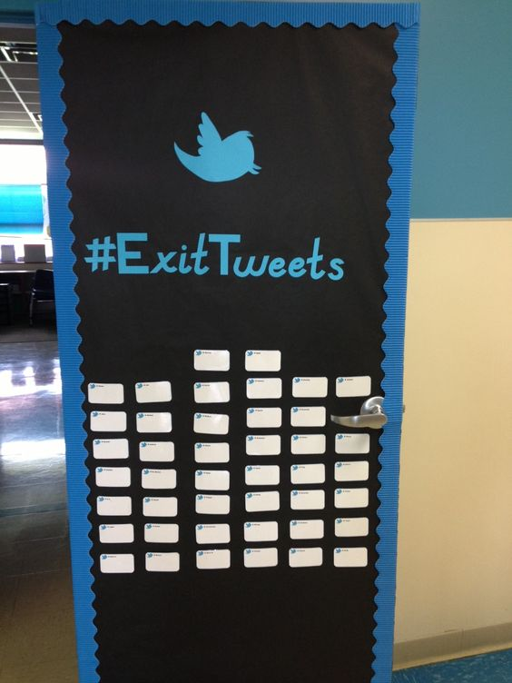
Exit Ticket
Write a tweet (140 characters) about one way differentiation can improve student learning in the classroom and why.
Image source: https://www.pinterest.com/explore/exit-tickets/
Notes:
Objective of this slide: to close out the session with participants examining what they learned.
Estimated time: 1 minute
Materials needed:
Sticky notes
Facilitator says:
To wrap up our session for our exit ticket, write a tweet about one way differentiation can improve student learning in the classroom and why. Please write it on a sticky note and place on the poster in the front of the room and sign your name.
[EXTRA. After the session break, the facilitator can group the sticky notes into 2-3 categories: “mastered objective, somewhat mastered objective, needs more support to master objective.” Then, the facilitator revisits differentiation at the beginning of the next session, addressing the exit ticket and responding to potential misconceptions.

Slide 20
AppendiX
©2017 Public Impact
Notes:
Facilitator says:
If we have time available now, or for participants who would like to explore on their own – here are additional resources on what reach associates can do to support differentiation.

Slide 21
Time for More: Walking Gallery
On each poster, write down an example of how you and your team of teachers carry out the following in your classroom. If you don’t have an example, you can create one!
1. Group students by common academic needs for some activities based on similar skill level
3. Give students choices for work options
2.Provide additional instruction to a students who struggle with a skill
4. Explain or model content for understanding in two or more approaches
Adapted from: McCarthy, J. Differentiated instruction is Just Too Difficult: Myth-Busting DI Part 3, Edutopia, 2015
Notes:
If Time Allows:
Objective of this slide: to explore specifics of what reach associates can do to support differentiation.
Estimated time: 10 minutes
Materials needed:
4 posters pre-labeled as shown on slide. Place each of the four posters in the 4 corners of the room (1) Grouping, (2) Additional Instruction, (3) Options, (4) Two or more approaches. Each poster has a column for examples and a column for challenges.
Markers
Facilitator says:
Let’s switch things up and take a quick walking gallery to move around the room to get our creative juices flowing. On each poster, write down an example. If you don’t have an example, you can create one! After 5 minutes, we’ll walk around the posters again to see the responses.
Group students by common academic needs for some activities based on similar skill level
Provide additional instruction such to a students who struggle with a skill
Give students choices for work options
Explain or model content for understanding in two or more approaches

